Slide 1
Introduction to Koha

Slide 2
Introductions
Kathryn Tyree, Project Manager
@kathrynpipesup
Chris Cormack, Software programmer
@ranginui

Slide 3
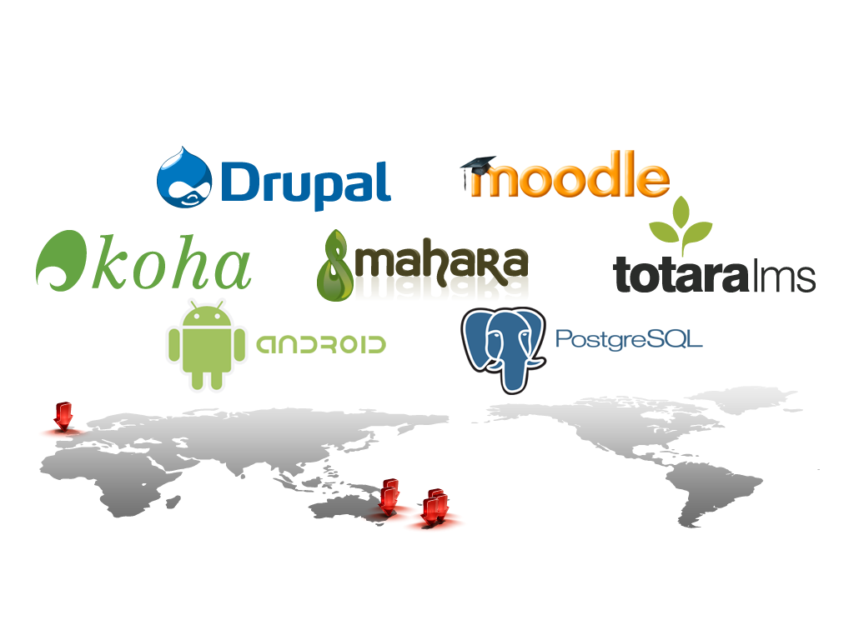
About Catalyst

Slide 4
Koha support
Koha can be hosted and supported by Catalyst, or on servers within your organisation with Catalyst support
Libraries only pay for the services and support they need
Catalyst stand behind Koha as a product, and guarantee our work.

Slide 5
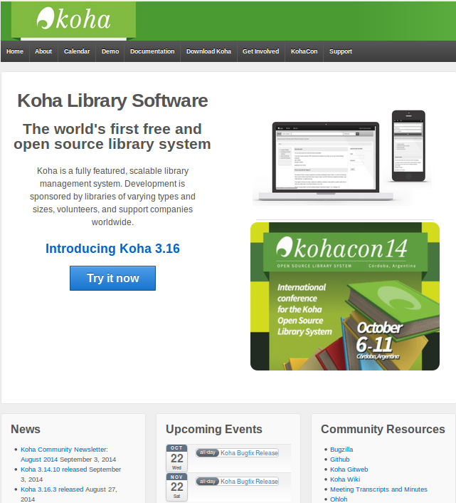
koha-community.org

Slide 6
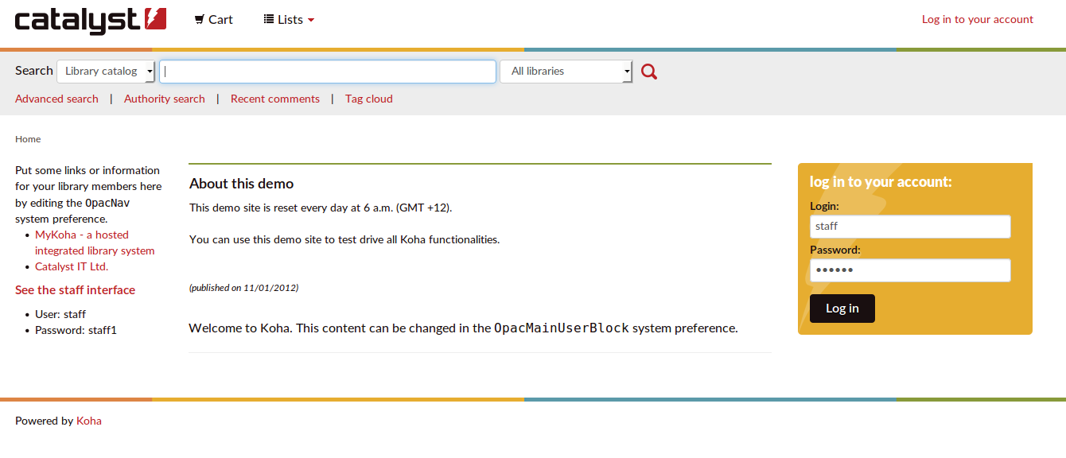
OPAC / Public interface

Slide 7
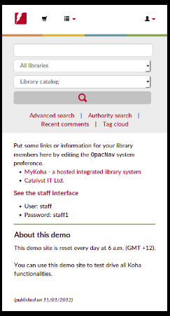
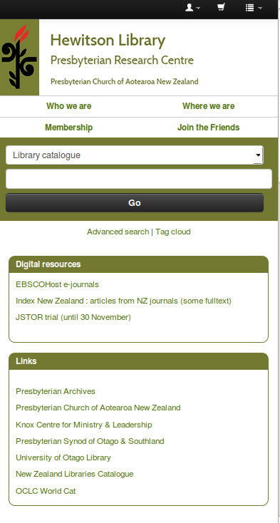

Slide 8
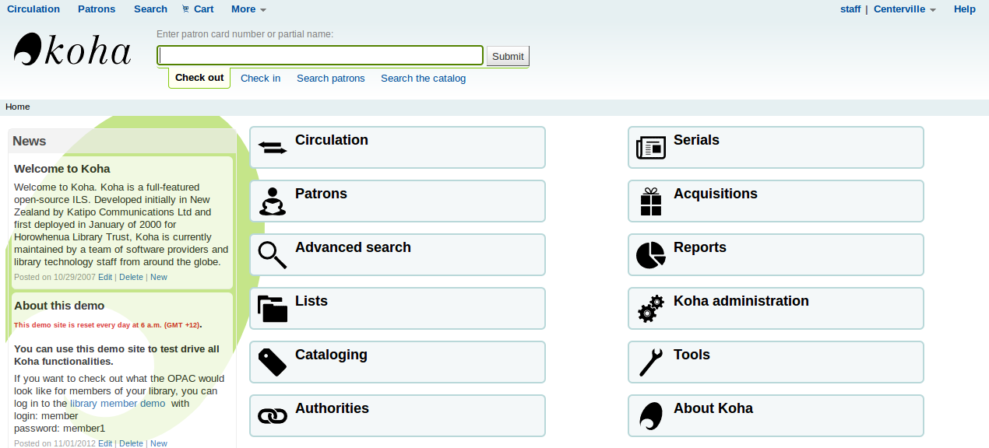
Staff interface

Slide 9
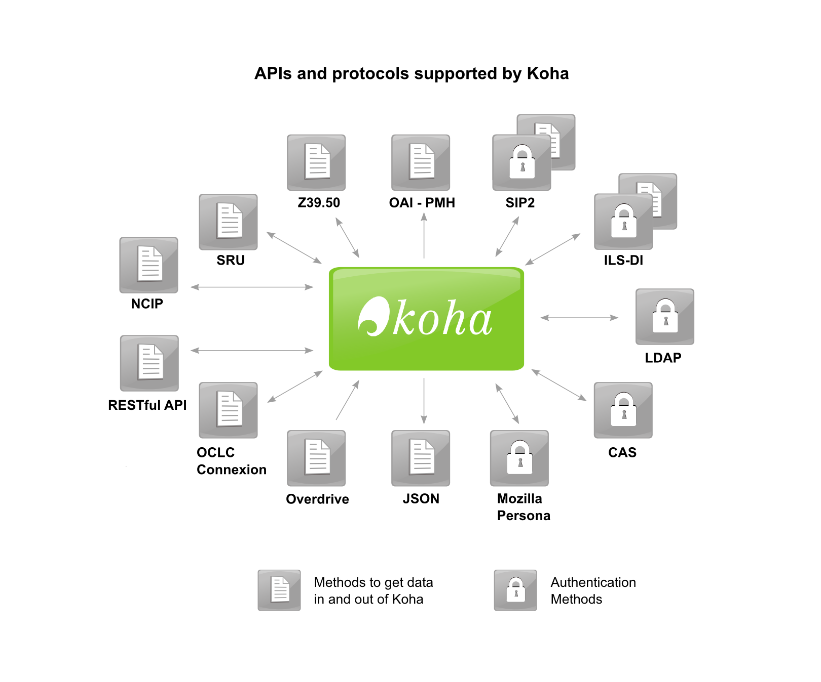
Open integration (it's a platform)

Slide 10
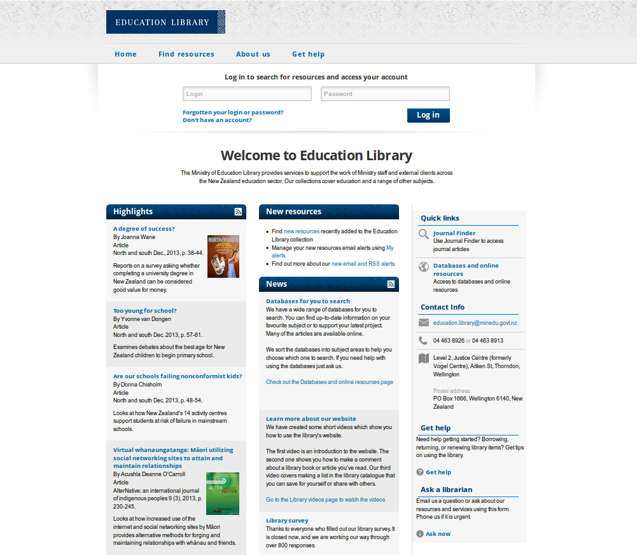
Integration e.g. with a Drupal website

Slide 11

Koha as discovery layer

Slide 12
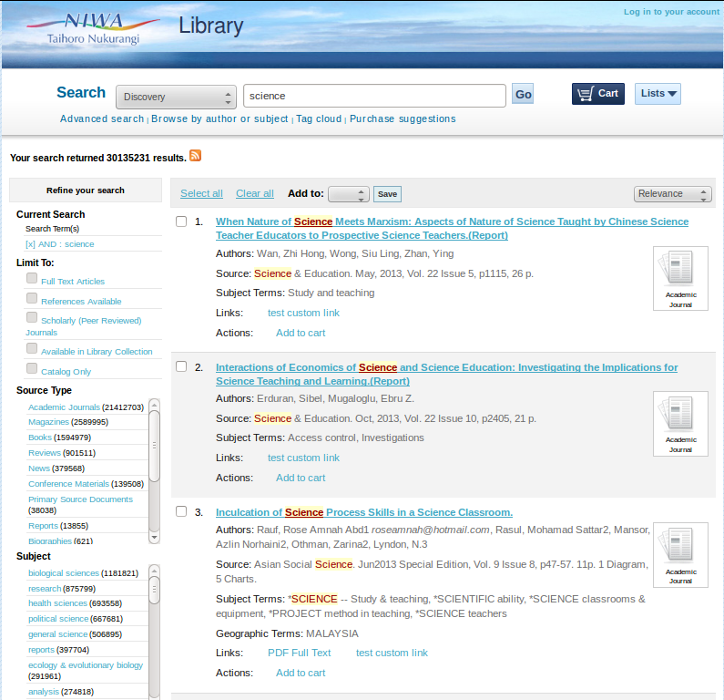
Koha as discovery layer (results)

Slide 13
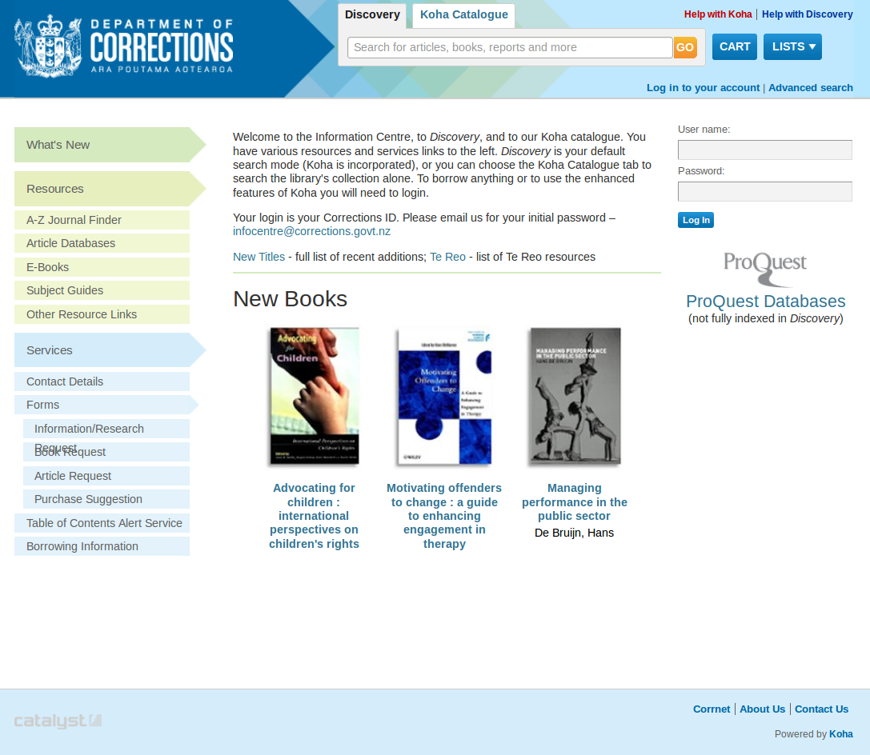
Koha as discovery layer

Slide 14
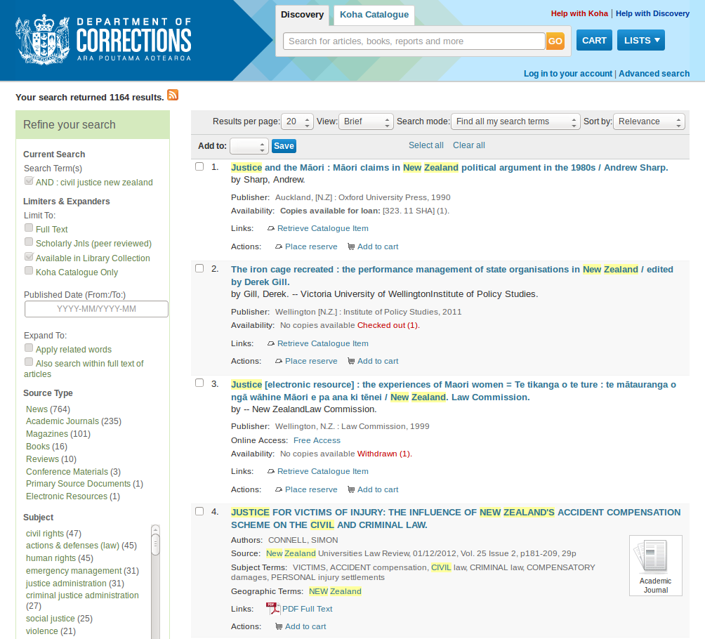
Koha as discovery layer – results

Slide 15
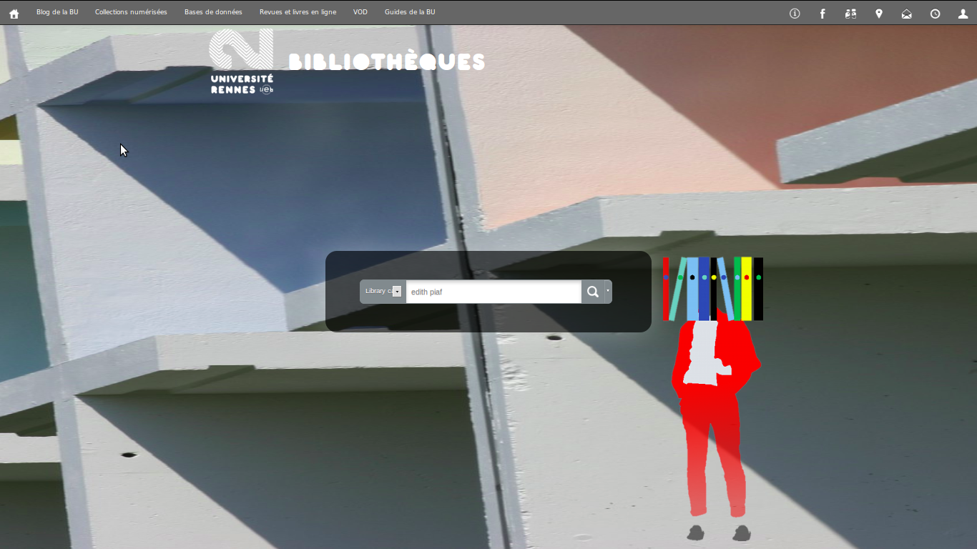
Koha as discovery layer

Slide 16
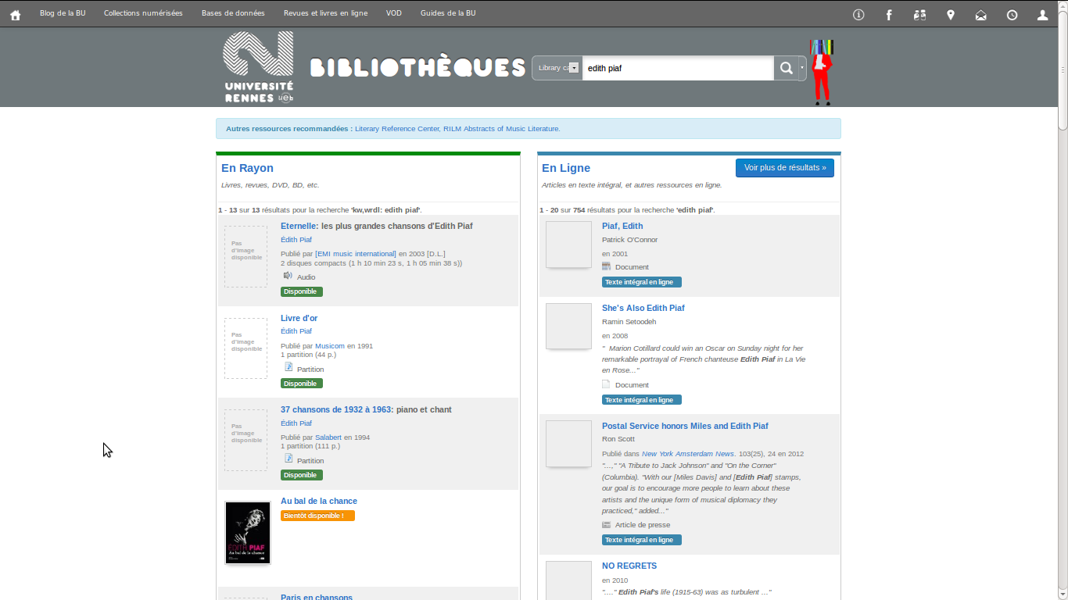
Koha as discovery layer - results

Slide 17

Pull in data from other sources

Slide 18
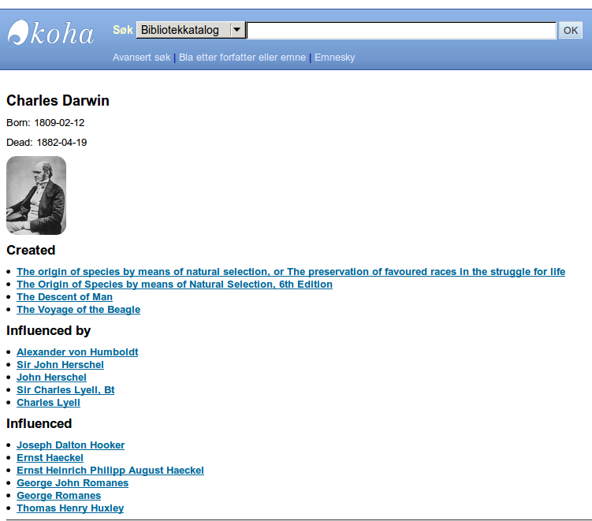
Linked data (preparing for Bibframe, RDF)

Slide 19
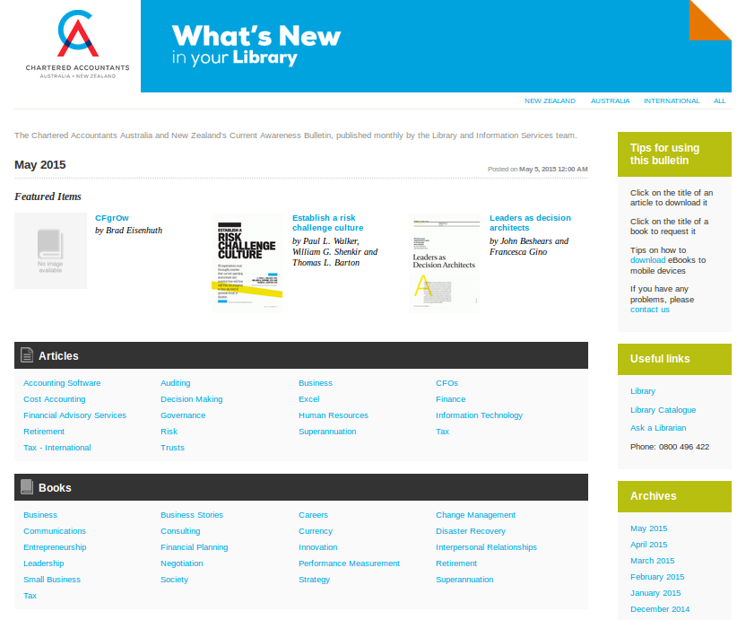
Display your data in other useful ways

Slide 20
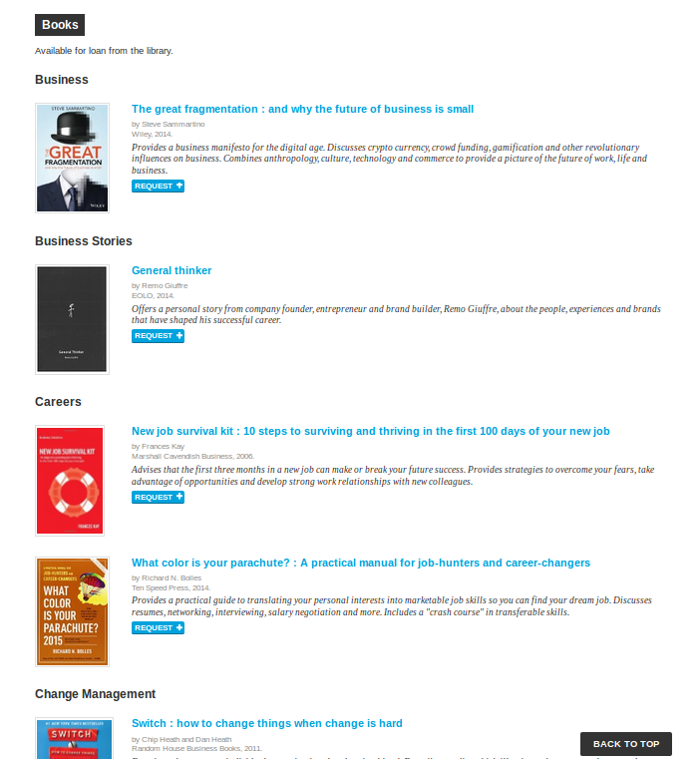

Slide 21
Questions?

Slide 22
Koha Implementation project
Takes around 3 months, plus time for integration and development if desired
Remote and on-site support provided by Catalyst throughout.

Slide 23
Overview of Koha implementation project
Agree requirements: design, development, integration, hosted by Catalyst or the Library
Data Migration
Initial training
Refinements and data clean up
Development and integration
Design
Pre go-live training
Go-live
Post go-live refinements
Ongoing maintenance and support

Slide 24
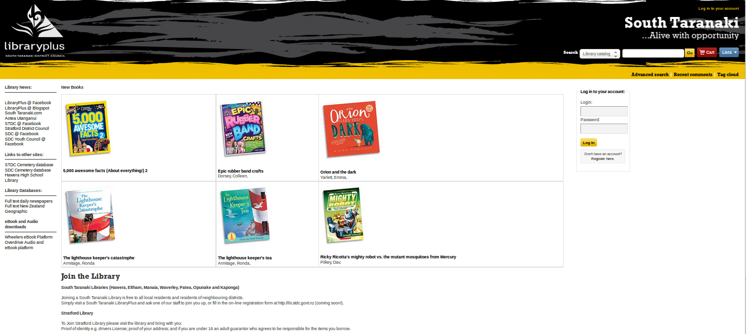

Slide 25


